Slide 1
DC Wall Box
HMI – IMX 8M plus

Slide 2
SW component inside iMX – Phytech board
DC Wall box – Connectivity proposal
Display Unit
Data Interface Engine
module derives insights/ conclusions from the input data CAN inputs
Publishes data to be displayed on display unit via MQTT
Forwards event info from display unit to CAN API block for generating CAN frames
CAN API block
Provides wrapper APIs for CAN send and receive messages
Eg: getCAN(ID), setCAN(ID)
Native CAN Driver
OS supported CAN driver
Display Unit
Data Inference Engine
MQTT
API Calls
CAN API –
Send/ Receive
Native CAN driver
iMX Board
CAN Bus
charcon
Vsec

Slide 3
Subcomponent -- SW subsets
DC Wall box – Connectivity proposal
CAN
CAN Dumps
Data Handling
MQTT
MQTT Broker
What to Pub/ Sub?
GSM
Bringing GSM up using APN codes – Auto detection
API
Send
Receive
CAN health Check
Startup
HIVE MQTT
Data Interface Engine
Compute function outputs – Hypothesis
Ping test periodically
GSM time for display
OTA
CAN Interface
MQTT interface
Pub/ Sub to HMI application
Comm to low level CAN API
Handle Event from HMI
Event to CAN
HMI App
Data Interface Engine
Identified key work package
SW component discretization
Development Language
Data Interface Engine – Python
HMI – C++
MQTT broker
HIVE MQTT
HMI
LVGL
HMI
LVGL
Operating System
Yocto Linux
IMD
Digital input output read
Cloud
Solar Irradiation – Mechanism to fetch this data
Logging
Event Management
Variable Mapping
Event Pub/ Sub
UI team for Graphic development
Image handling
License open source
Startup scheduling
Scheduling sequence of Data interface Engine and HMI app
PWM for understanding the system state
Export longs
SW update
System Logger
CAN Dumps
Data Interface Engine logging
HMI logging*
TBD
HMI Team
Collaborative
Workshop on Work package analysis (5th Sep): PJ-CSS, EHM-PD3-PJ3

Slide 4
Subcomponent -- SW subsets –plan for CW37
DC Wall box – Connectivity proposal
CAN
CAN Dumps
Data Handling
MQTT
MQTT Broker
What to Pub/ Sub?
GSM
Bringing GSM up using APN codes – Auto detection
API
Send
Receive
CAN health Check
Startup
HIVE MQTT
Data Interface Engine
Compute function outputs – Hypothesis
Ping test periodically
GSM time for display
OTA
CAN Interface
MQTT interface
Pub/ Sub to HMI application
Comm to low level CAN API
Handle Event from HMI
Event to CAN
HMI App
Data Interface Engine
CAN
Generic CAN SEND/ RECEIVE API
Schedule CAN Receive and Send
CAN dumps
MQTT Broker
Install HIVE MQTT broker
Concept of DIE ←→ HMI app MQTT messages
DIE page numbers and HMI app must display the page
GSM
Bring GSM up on iMX board
Wifi check
Wifi connection from app
Log
CAN Dumps
DIE log
HMI log
HMI
LVGL
Operating System
Yocto Linux
IMD
Digital input output read
Cloud
Solar Irradiation – Mechanism to fetch this data
Logging
Event Management
Variable Mapping
Event Pub/ Sub
UI team for Graphic development
Image handling
License open source
Startup scheduling
Scheduling sequence of Data interface Engine and HMI app
PWM for understanding the system state
Export longs
SW update
System Logger
CAN Dumps
Data Interface Engine logging
HMI logging*
TBD
HMI Team
Collaborative

Slide 5
Subcomponent -- SW subsets
DC Wall box – Connectivity proposal
CAN
CAN Dumps
Data Handling
MQTT
MQTT Broker
What to Pub/ Sub?
GSM
Bringing GSM up using APN codes – Auto detection
API
Send
Receive
CAN health Check
Startup
HIVE MQTT
Data Interface Engine
Compute function outputs – Hypothesis
Ping test periodically
GSM time for display
OTA
CAN Interface
MQTT interface
Pub/ Sub to HMI application
Comm to low level CAN API
Handle Event from HMI
Event to CAN
HMI App
Data Interface Engine
Identified key work package
SW component discretization
Development Language
Data Interface Engine – Python
HMI – C++
MQTT broker
HIVE MQTT
HMI
LVGL
HMI
LVGL
Operating System
Yocto Linux
IMD
Digital input output read
Cloud
Solar Irradiation – Mechanism to fetch this data
Logging
Event Management
Variable Mapping
Event Pub/ Sub
UI team for Graphic development
Image handling
License open source
Startup scheduling
Scheduling sequence of Data interface Engine and HMI app
PWM for understanding the system state
Export longs
SW update
System Logger
CAN Dumps
Data Interface Engine logging
HMI logging*
TBD
HMI Team
Collaborative
Workshop on Work package analysis (5th Sep): PJ-CSS, EHM-PD3-PJ3

Slide 6
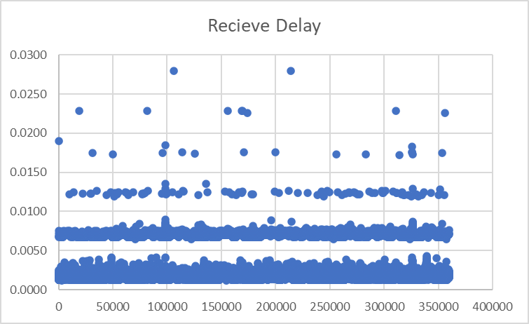
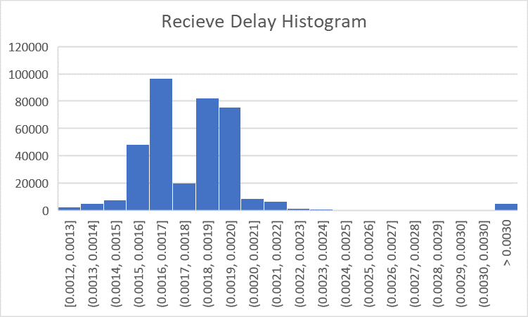
12-Oct Workshop Status
DC Wall box Status
CAN
Robust test done for IMX send/ receive
Ping pong communication between Pi and IMX8. 2ms for one round trip for one CAN frame
Tested for 1 hour and 360000 frames were handled without any loss
Communication with Charcon established.
APIs are tested and CAN matrix internally implemented for all required signals
DIE – Data interface engine
CAN and MQTT interface concept created and implemented.
CAN signals from vSECC* and Charcon* were interpreted and processed data was sent back as CAN Frames
DIE able to switch HMI pages via MQTT as per the CAN signal received.
HMI
Screens: Initialization, Charging, Health Check, Ready to Charge, Device failure implemented
MQTT broker and other dependencies installed in linux image
Hardware Interface – Digital I/O
Digital input and output signals tested in IMX board
CAN send/ receive time
* CANOE test

Slide 7
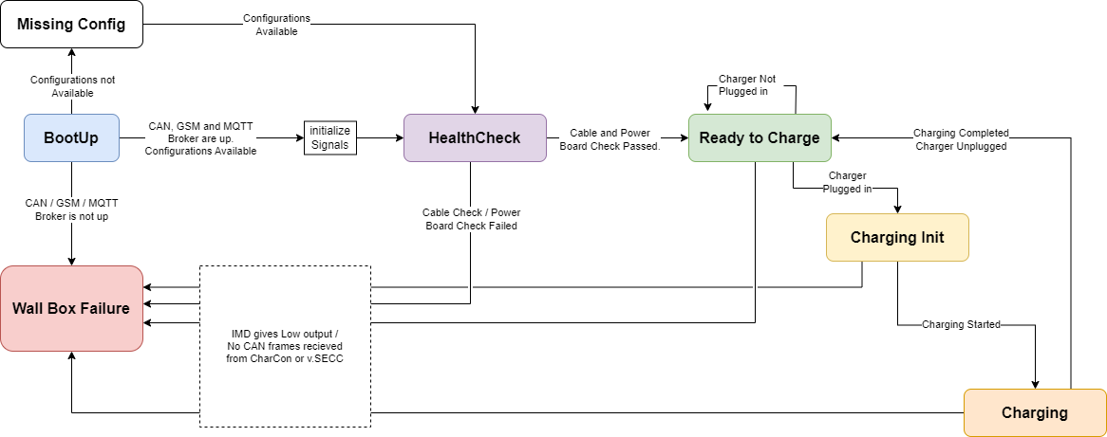
Data Interface Engine – State diagram
DC Wall box Status

Slide 8
TO DO
DC Wall box Status
System integration
Vehicle to be simulated in HIL environment for testing vSECC functionality
Support required Vector VT Simulator
Digital inputs
DC contractor requires relays, as opto-coupler could not provide enough driving current
IMD to be tested (possibly for high voltage)
Test planned to be tested with low voltage
Communication with vSECC to be established
Data Interface Engine
Charging state to implemented
Complete system integration test
Cloud connectivity
HMI
GSM

Slide 9


Status – 7th Sep
DC Wall box – Connectivity proposal
CAN Frame dumps
System Sequence diagram
HMI app 2 pages
ToDo
Timeline planning and feature prioritization – Workshop with HMI 8th Sept planned
Porting developed SW artefacts to iMX board

Slide 10
CAN
DC Wall box – Connectivity proposal
Socket CAN implementation using python CAN module
CAN Send and Receive using Threads
How much (Size) CAN dumps to log..?

Slide 11




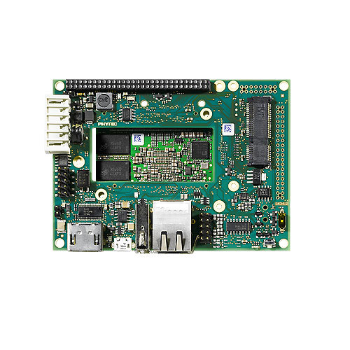
AWS – Cloud Connectivity
DC Wall box – Connectivity proposal
Solar Irradiation – Mechanism to fetch this data
Export longs
SW update
Cloud
AWS Cloud
What to exchange with cloud?
Charging Session
Solar irradiation
Logs – Data Interface Engine & HMI logs
FOTA – SW update (Data Interface Engine & HMI)
User Authentication
Charging Session from IMX to AWS cloud
Charging current & voltage, start & end time of charge session, etc TBD.. (Navneeth & Pritam)
JSON format – Web socket – OCPP2.0.1 standard
OCPP Python package (Poojitha)
Solar Irradiation
AWS will fetch from Open Weather API based on request from iMX (Navneeth)
Comm between iMX – AWS cloud
Charging session – OCPP - Websockets
Logs export – End of charging session logs are updated to cloud - https
Solar irradiation – https – REST API
AWS Cloud
iMX Board
Solar Irradiation
Weather API (Open Weather)

